Slide 1

Working with Application Frameworks and ArcGIS API for JavaScript
Matt Driscoll (@driskull)
Derek Swingley (@derekswingley)
Notes:
Overall flow could be…
Matt: slides 2 and 3
Derek: slides 4 and 5
Matt: slide 6
Derek: slide 7
Matt: slide 8
Slides 9 and 10…doesn’t matter

Slide 2




JavaScript-based Application Frameworks
MVC
Notes:
Briefly intro MVC: models are your data, views are representations of models and controllers handle your logic as well as communication between models and views.
-Matt talk about MVC.
Each framework does things in their own way, but the underlying concepts are the same.
The clipboard icon is a link to http://todomvc.com/ which has examples for every major JS-based MVC framework in use today. It’s worth telling session attendees about this resource so they can explore it later.

Slide 3
Why?
Separation of concerns
DRY
Easy to test
Fun (do more with less code)
Notes:
Separation of concerns: your JS shouldn’t be directly updating your DOM. Modularize your data, application logic and your presentation of information.
DRY: don’t repeat yourself: do things in one place, easier to maintain your code, less error prone.
Testing: we are not talking about testing here, but one of the primary reasons to use these frameworks is so that you can easily unit test your apps.
Fun: write less boilerplate/scaffolding, focus on doing tasks unique to your app. Creating/disconnecting events. Let
Matt– you wanna take this one?

Slide 4
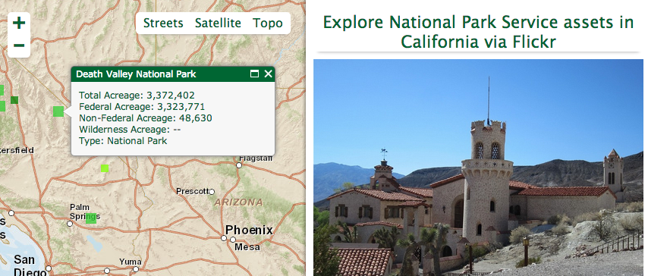
First, we need an app…
Notes:
Originally built a couple of years ago with a previous release of the ArcGIS API for JavaScript. All JS API + Dojo. No MVC… manually manipulating DOM, concatenating strings…got the job done, and many, many apps are built this way, but there are tons of places for improvement.
TODO: image needs to link to the app, preferably running on github pages. Demo the app…show clicking on a point, then clicking through photos.

Slide 5
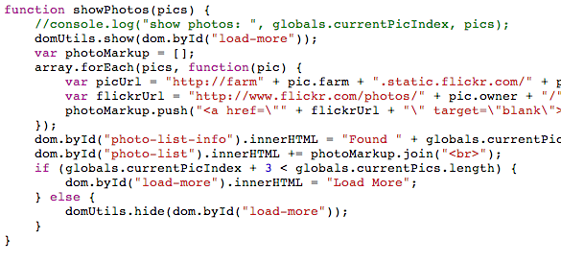
Notes:
Example of what we’re going to try to avoid… hard-coded references to DOM elements, manually building HTML and injecting it.
Side note: the function shown here isn’t actaully a global as it lives inside the require() callback…so it’s not all bad ☺.

Slide 6
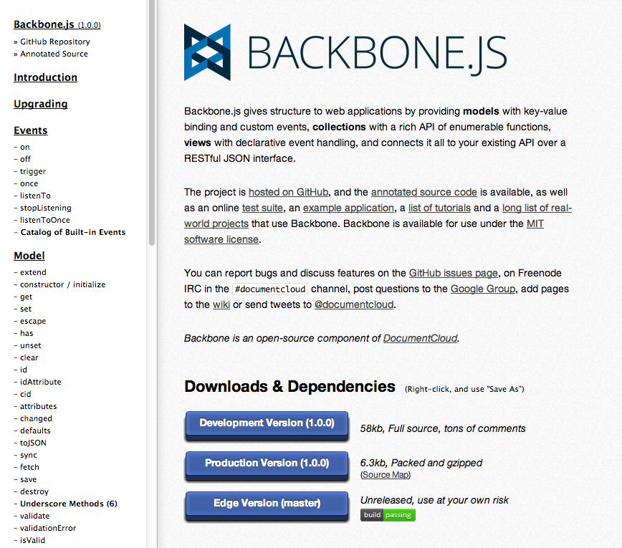
Backbone.js

Slide 7
Features
Models
Views
Events
Collections
Routes
History
Notes:
Models
-Handle functionality of your app and changes that happen.
Views
- Views are backed by models and can update views when the model changes
- Can be used with any templating library, for this app I used Underscore templates.
Events
- Similar to dojo events. Has .on() and .off() to bind events to an object.
Collections
- Allows you to bind events on a collection of models
- Listen to multiple models
Routes
- Has a router than handles URL in page links like hash tag anchor links and redirects them to a function.
- Great for single page apps that want to link to a specific function
History
- Once all your routes are created, a history can be started to be able to use the back button within your single page app

Slide 8
Pros
Wide adoption
Clear MVC implementation
Routers / History
Underscore Helper Functions
Cons
Dependencies
$
_
Notes:
First up: Backbone. Probably the jQuery of JS MVC frameworks.
This one’s for you Matt!

Slide 9
Pros
Docs/Tutorials
Built-in AJAX / JSONP
Magic
Google
Cons
Fuzzy MVC implementaiton
Non-standard markup (ng-*)
Magic
Google
Notes:
Next: Angular.

Slide 10
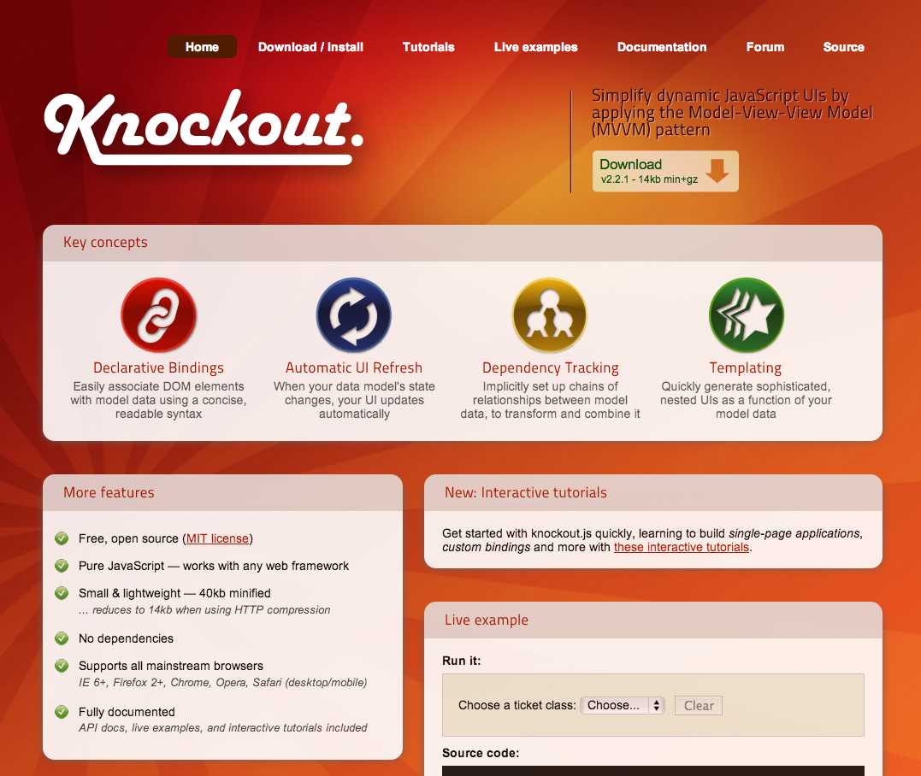
Knockout.js

Slide 11
Features
View-Models
Observables
Bindings
Templates

Slide 12
Pros
No dependencies
Uses AMD if define found
Good docs & examples
Cons
No routes/history
HTML can become bloated with bindings
Notes:
Make sure Dojo or require.js is loaded before Knockout so that define is defined

Slide 13
?

Slide 14
Matt Driscoll (@driskull)
Derek Swingley (@derekswingley)
Tuesday, March 26th – Offering ID: 216
Thursday, March 28th – Offering ID: 394

